Slide 1
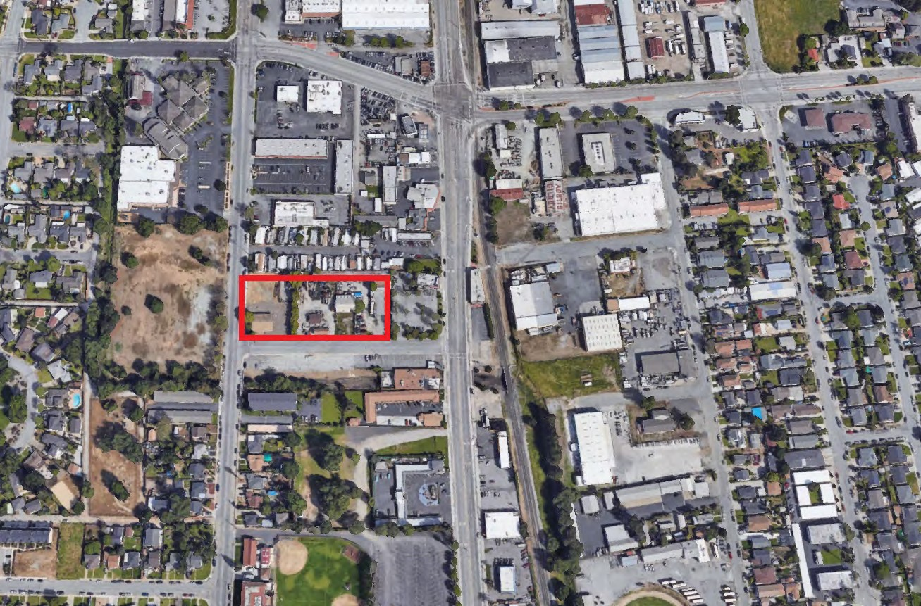
Mixed Use Land For Sale
95, 101, 105 Howson Street & 8200 Church Street
Gilroy, CA 95020
Features
APN: 790-36-012
1.96 Acres (85,378 SF) Zoned: Downtown Gateway
District (FAR of 0.75 / up to 30
DU per acre)
Large In-Fill Site just off of Monterey Highway near Schools, Parks, Retail and Public Transportation. Located just north of Gilroy’s Downtown Core.
Price: $4,750,000
1.96
Acres
Exclusive Agents
Doug Ferrari
408.879.4002
dferrari@primecommercialinc.com CA BRE 01032363
Dixie Divine
408.879.4001
ddivine@primecommercialinc.com CA BRE 00926251 & 01481181
1543 LAFAYETTE STREET · SUITE C · SANTA CLARA, CA · 95050 · OFFICE 408.879.4000 · FAX 408.879.4004 · WWW.PRIMECOMMERCIALINC.COM
Prime Commercial, Inc. has obtained the information contained herein from sources we deem reliable. However, we have not verified its accuracy and make no guarantee, warranty or representation about it. It is subject to errors, modification, omission, change of price and/or terms, prior lease sale or financing, or withdraw without notice. It may include projections, opinions, or assumptions or estimated for example only, and they may represent current or future performance of the property. You and your tax and legal advisors should conduct your own of the property and transaction. The information provided in this brochure are estimate sonly, not representations, and are not intended to be relied upon for any purpose. All demographic information contained in this brochure is obtained from STDB.

Slide 2
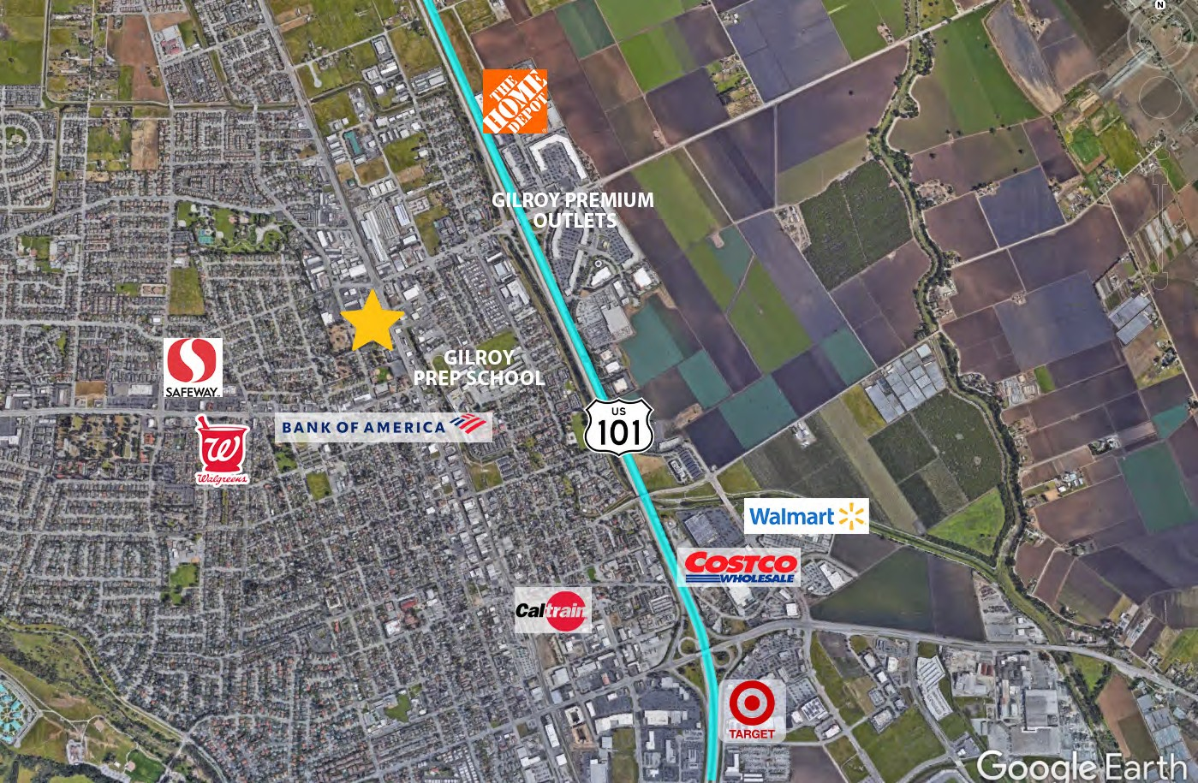
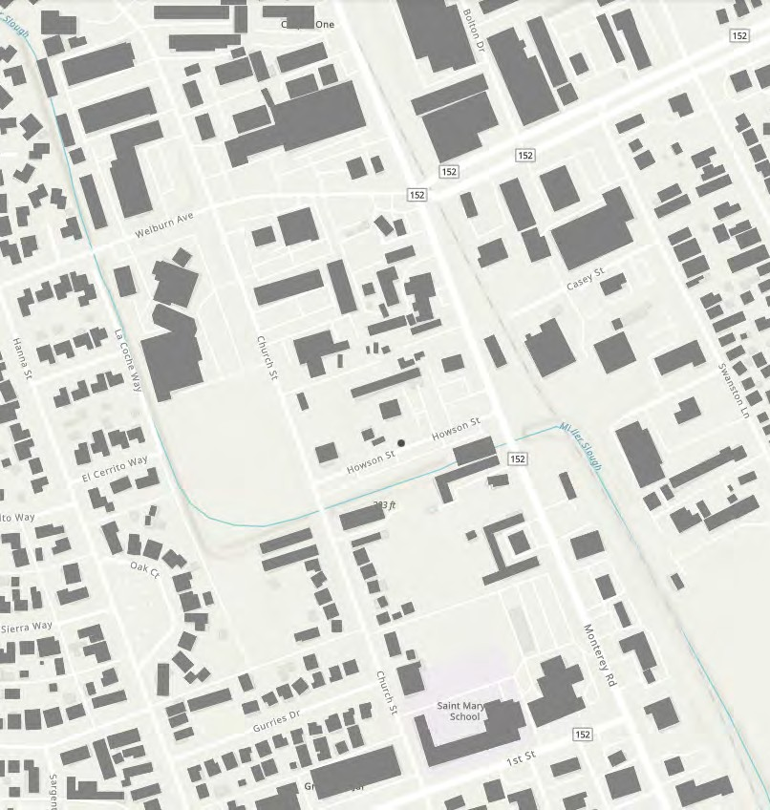
Mixed Use Land For Sale
95, 101, 105 Howson Street & 8200 Church Street
Gilroy, CA 95020
Exclusive Agents
Doug Ferrari
408.879.4002
dferrari@primecommercialinc.com CA BRE 01032363
Dixie Divine
408.879.4001
ddivine@primecommercialinc.com CA BRE 00926251 & 01481181
1543 LAFAYETTE STREET · SUITE C · SANTA CLARA, CA · 95050 · OFFICE 408.879.4000 · FAX 408.879.4004 · WWW.PRIMECOMMERCIALINC.COM
Prime Commercial, Inc. has obtained the information contained herein from sources we deem reliable. However, we have not verified its accuracy and make no guarantee, warranty or representation about it. It is subject to errors, modification, omission, change of price and/or terms, prior lease sale or financing, or withdraw without notice. It may include projections, opinions, or assumptions or estimated for example only, and they may represent current or future performance of the property. You and your tax and legal advisors should conduct your own of the property and transaction. The information provided in this brochure are estimate sonly, not representations, and are not intended to be relied upon for any purpose. All demographic information contained in this brochure is obtained from STDB.

Slide 3
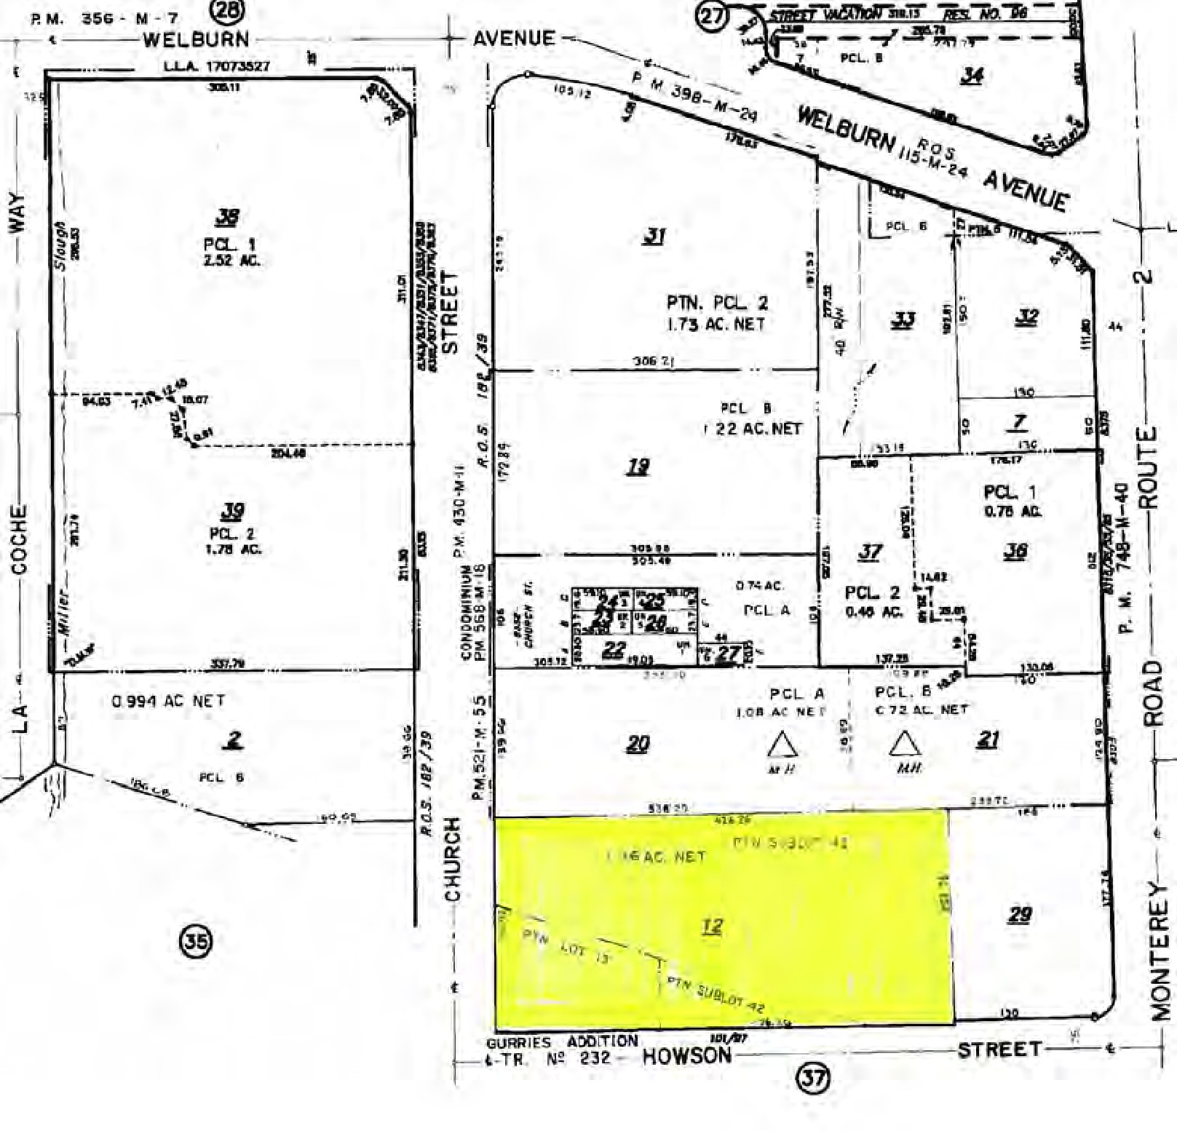
Mixed Use Land For Sale
95, 101, 105 Howson Street & 8200 Church Street
Gilroy, CA 95020
LOCATION
The subject property is located in the city of Gilroy at the northeast corner of Church and Howson Streets. Gilroy is one of fifteen incorporated cities that lies in the southern most region of Santa Clara County. Historically, the economic engine in Gilroy was based in agriculture with its primary crops being prunes, onions, flowers, and of course garlic. Gilroy is also home to several food processing companies that employ many local residents. Additionally, Gilroy is known for its Premium Outlets which draws shoppers from all over Northern California and from the central coast. Recently, Amazon announced that it purchased 66 acres of vacant land just south of the Premium Outlets.
PLAT MAP
The immediate neighborhood is primarily developed with commercial uses along Monterey Highway with residential enclaves to the west. The site has excellent access to U.S. Highway 101 less that one-half mile to the east via Leavesley Road. The subject sits at the northern gateway to downtown Gilroy and just one mile north of the Cal Train Station/Gilroy Transit Corridor which provides rail and bus service north to San Jose and other communities in Santa Clara County.
DEMOGRAPHICS
 | 1 MILE | 3 MILES | 5 MILES
POPULATION | 22,331 | 60,144 | 67,999
AVERAGE HH INCOME | $104,347 | $138,756 | $143,115

Slide 4
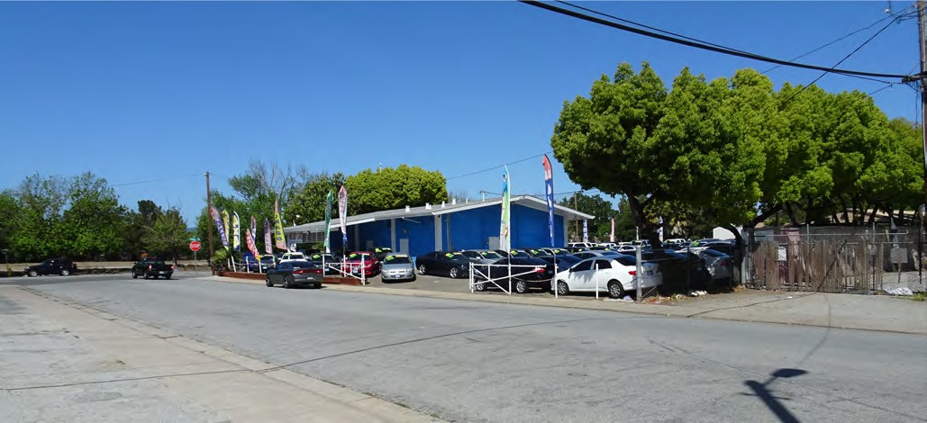
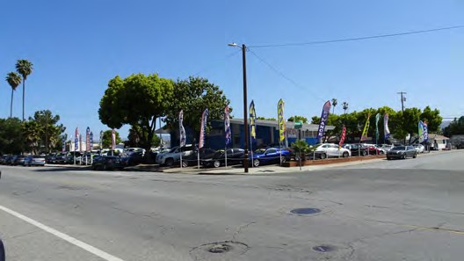
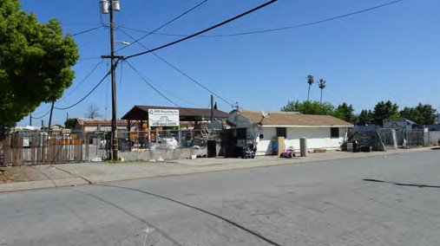
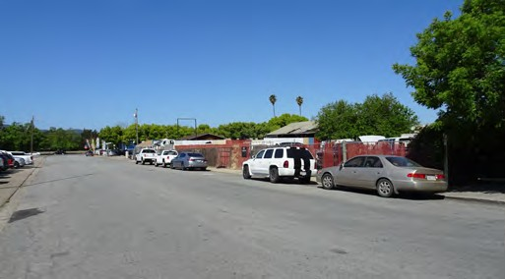
Mixed Use Land For Sale
95, 101, 105 Howson Street & 8200 Church Street
Gilroy, CA 95020
Exclusive Agents
Doug Ferrari
408.879.4002
dferrari@primecommercialinc.com CA BRE 01032363
Dixie Divine
408.879.4001
ddivine@primecommercialinc.com CA BRE 00926251 & 01481181
1543 LAFAYETTE STREET · SUITE C · SANTA CLARA, CA · 95050 · OFFICE 408.879.4000 · FAX 408.879.4004 · WWW.PRIMECOMMERCIALINC.COM
Prime Commercial, Inc. has obtained the information contained herein from sources we deem reliable. However, we have not verified its accuracy and make no guarantee, warranty or representation about it. It is subject to errors, modification, omission, change of price and/or terms, prior lease sale or financing, or withdraw without notice. It may include projections, opinions, or assumptions or estimated for example only, and they may represent current or future performance of the property. You and your tax and legal advisors should conduct your own of the property and transaction. The information provided in this brochure are estimate sonly, not representations, and are not intended to be relied upon for any purpose. All demographic information contained in this brochure is obtained from STDB.

